Slide 1

Project Title : Gait as a Biometric
Project Guide : Prof. Dinesh Babu Jayagopi
Participants:
Akanksha Dwivedi - MT2016006
Tarini Chandrashekhar – MT2016144

Slide 2
Introduction
Human Identification involves biometric features such as fingerprints/palm-prints, face, signatures etc. but the problem with these features is that they require specific devices to capture these features.
Here is where gait classification is beneficial because it requires just a single camera and is an effective and non-intrusive way of recognizing different subjects.
There are two prominent methods to perform gait classification : Silhouette based and Optical Flow based.
We will discuss both approaches and why we opted for Optical flow approach over the Silhouette based approach.

Slide 3
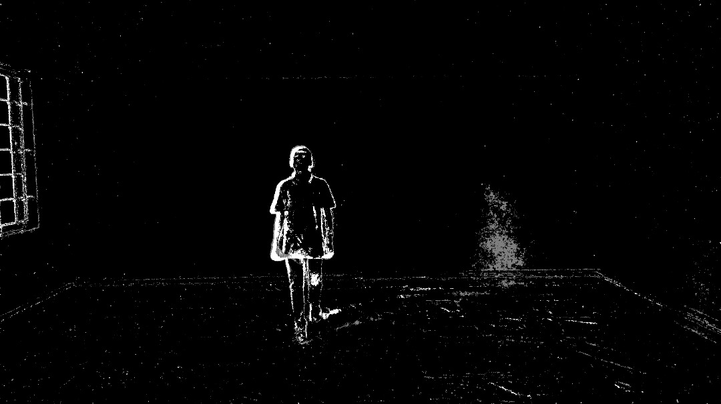
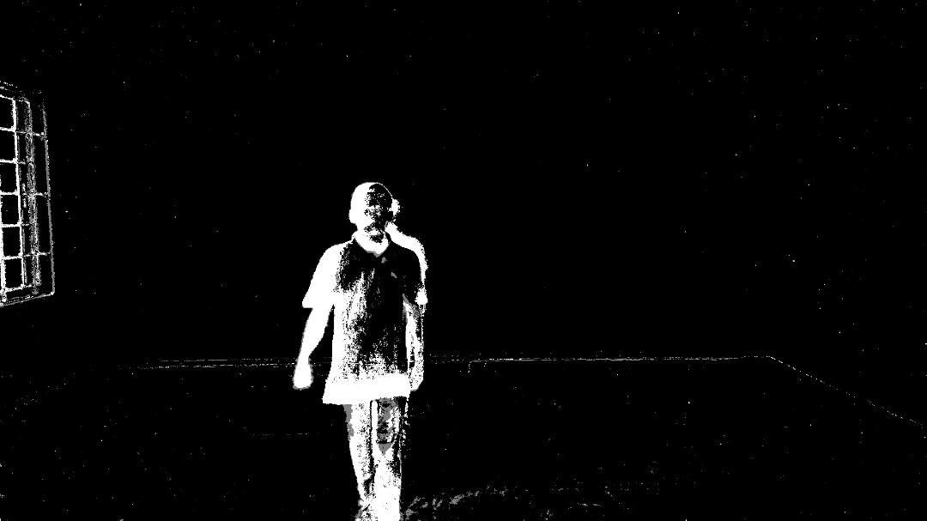
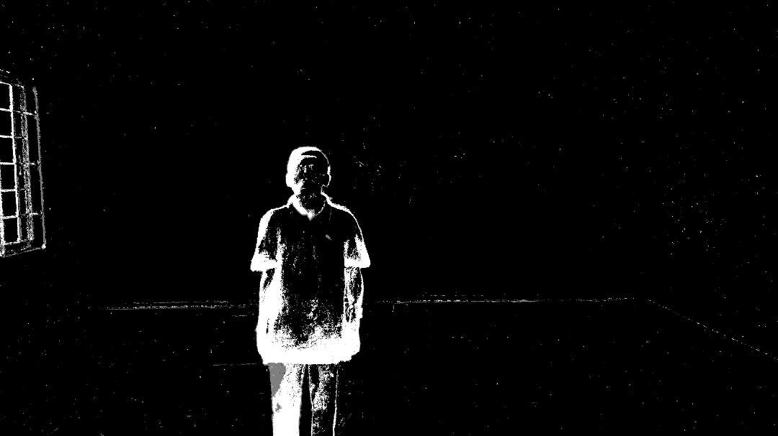
Silhouette-based approach
The method is based on matching 2D silhouettes extracted from key frames across the gait sequence.
Even though it has a lot of pros like tolerance of noisy video data, ease of implementation, insensitivity to clothing and texture, generalization across different walking gaits, the main drawback is that it is view dependent – cannot classify the subjects viewed from significantly different angles than the training subjects.
Its comparison criteria with the testing samples depends on Gait Energy Image(GEI), which is an estimated average of all the silhouettes.

Slide 4
Optical Flow Approach
We have used the optical flow approach in our gait classification task, which can be broken down into the following steps:
The system converts the input color images to gray level images.
We employ optical flow algorithm on the image sequence to get the flow field with respect to two contiguous frames and use the difference in optical flow between the two frames to draw a bounding box around the object.

Slide 5
Now, we construct flow histogram for each frame based on the polar component of flows inside the bounding box. Since, the number of frames differ for each video, we calculate a discerning feature called Gait Cycle for each subject which is unbiased.
After finding the unbiased feature, we use PCA and LDA to find the best projected feature space.
Finally, we use different traditional (non-neural network) machine learning models for the best recognition results.

Slide 6
DATASET
We used a collection of 26 videos, some of which were shot by a simple phone camera, and some by a classic DSLR camera on a tripod.
The videos were of 360p resolution.
The average duration of the videos is 6-8 seconds.
Most of the walk observed in the dataset consists of the subject walking perpendicular to the camera view, however we later concluded that YOLO detection works with the the subject, irrespective of the camera angle.

Slide 7
Moving object detection
We have employed two separate methods for moving object detection, with varying levels of accuracy.
Blob Analysis – First, a mask is obtained by applying a foreground detector, to discern the foreground object from the rest of the image, and then Blob Detector is employed to detect the consistent image regions. We got 70-80 % frames with good bounding boxes.
YOLO detection – You Only Look Once (YOLO) is a real-time object detection which uses a a single pre-trained neural network model on the entire image. It predicts varying objects in a single frame with varying weighted probabilities. It looks at the whole image at test time so its predictions are informed by global context in the image, so the detection is 100 percent accurate, with respect to the bounding box.

Slide 8
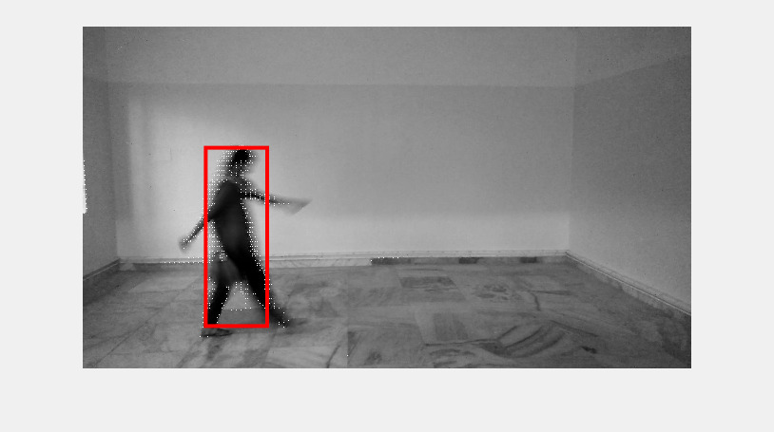
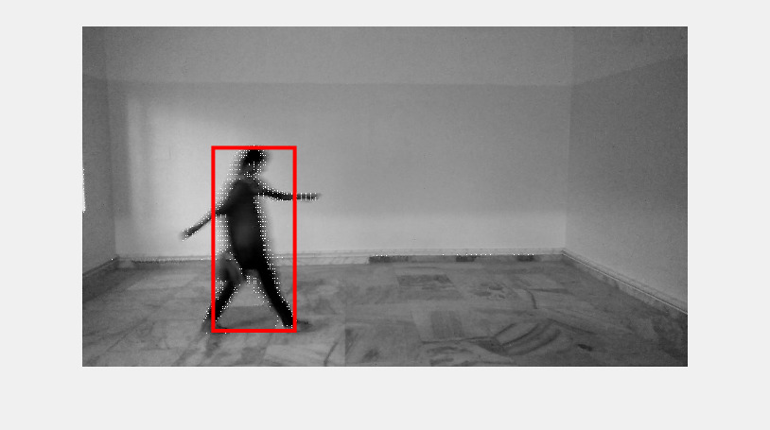
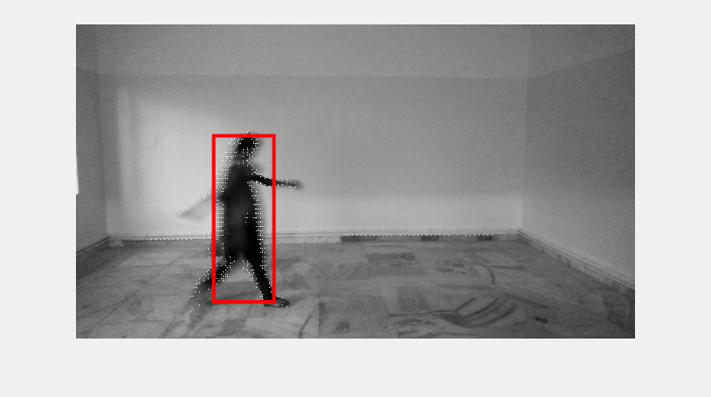
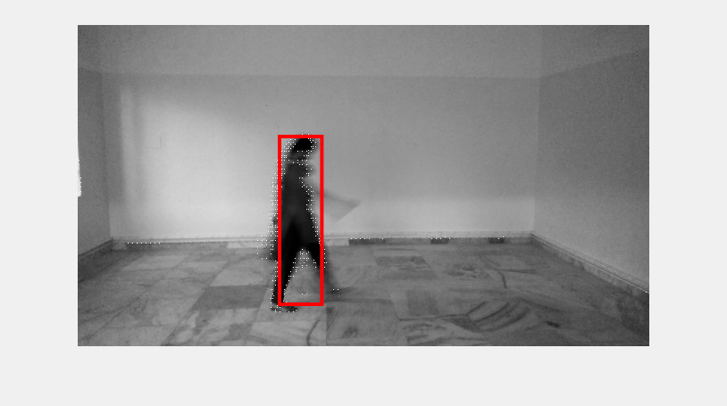
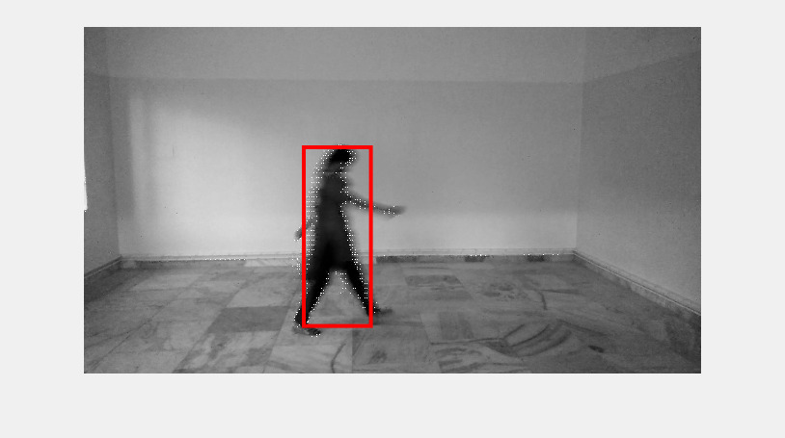
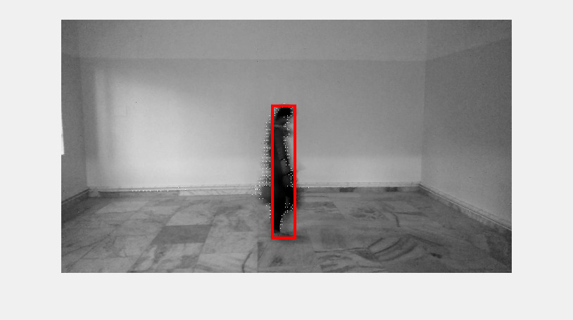
Bounding boxed with Blob Analysis

Slide 9
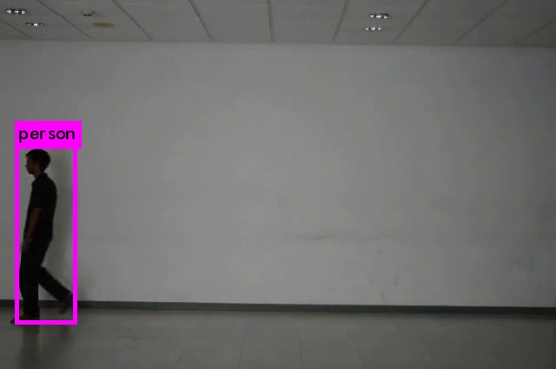
Bounding Box with YOLO Detection

Slide 10

Histogram Construction
After obtaining the bounding box of the moving object, we consider the optical flow information inside the bounding box to construct a bivariate flow histogram. The optical flow of each pixel has a horizontal and a vertical component. We transform the cartesian optical flow values (u,v) to polar coordinate system (r,𝚹).
The flow histogram is constructed according to the values of r and 𝚹. We quantize r and 𝚹 from 1 to 15 and 0 to 360 respectively. We need to normalize the histograms because of different size of bounding boxes across different frames of the video.
FH(i,j) = $\frac{FH(i,j)}{\sum{FH(i,j}} , 1≤i ≤15 , 0≤j≤360$ where i, j are indices of the flow histogram.

Slide 11


GAit cycle extraction
We perform histogram matching to extract the gait cycle, also known as gait signature. As we found out, it is unique to
every person, and hence, turns out to be a unique feature, which is later fed to a machine learning model.
Given a video sequence with T frames, we compute the gait similarity function d using the following equation:
$d\left(t\right)=f({FH}_{i}$ ,${FH}_{r})$ 1$≤i≤T$
Where ${FH}_{i}$ is the flow histogram at frame i and${FH}_{r}$ is the flow histogram of the reference frame. f is the $L_{2}$ -norm
similarity measurement function. The middle frame of the frame sequence is usually taken as the reference frame to
estimate the gait cycle accurately. We have implemented the concept of similarity measurement function in code using
Frobenius norm.

Slide 12

The red circles are the local maximum/minimum points which represent the best (lowest) or the worst (highest) matching results of dissimilarity. Similar gaits in different frames have small values so that we can regard a period between two peaks/valley as a gait cycle.
We take the frames between two best matched valley points (marked as green boxes) as a gait cycle. Finally, we can obtain an Averaged Flow Histogram (AFH) which is the “unique gait signature” using the following equation:
where $t_{1}$ and $t_{2}$ are the beginning and ending frame indices of a gait cycle
$AFH= \frac{\sum_{i=t_{1}}^{t_{2}}{{FH}_{i}}}{t_{2}−t_{1}}$

Slide 13
Dimensionality reduction
The average flow histogram we get is 15 dimensional because we have defined r from 0 to 15, so as a rule of thumb, we apply two well known dimensionality reduction techniques :
Principal Component Analysis (PCA) – We reduce the dimension of feature space, by finding 5 principal components, so as to project data to get maximum variance while preserving 99% of the original data.
Linear Discriminant analysis (LDA) - The data is reduced to a dimension N-1 classes where N is the number of classes/subjects. The direction of projection is such that between-class variance is the maximum and the within-class variance is the minimum, so as to prevent class overlap.
From our experimental analysis, we found that the performance of prediction with or without the dimensionality reduction was almost similar.

Slide 14
Experimental Analysis
We trained our data with five machine learning algorithms, namely- 1. K-nearest neighbor(kNN), 2. Support Vector machines (SVM) , 3. Multinomial Logistic Regression, 4. Linear Discriminant Analysis (LDA), and 5. Generalized Linear Regression (GLR) separately, to see the results of classification for each one of them individually. Following is a tabulation of the error rates for each model.
We get the least error and correct prediction when r=15, with kNN. We got the minimum classification error of 53% and best accuracy of 50% with the former.
Machine learning model | Error rate(when r=10)
kNN | 71%
SVM | 77%
MLR | -
LDA | 47%
GLR | -
Machine learning model | Error rate(r=15)
kNN | 53%
SVM | 59%
MLR | 59%
LDA | -
GLR | -

Slide 15
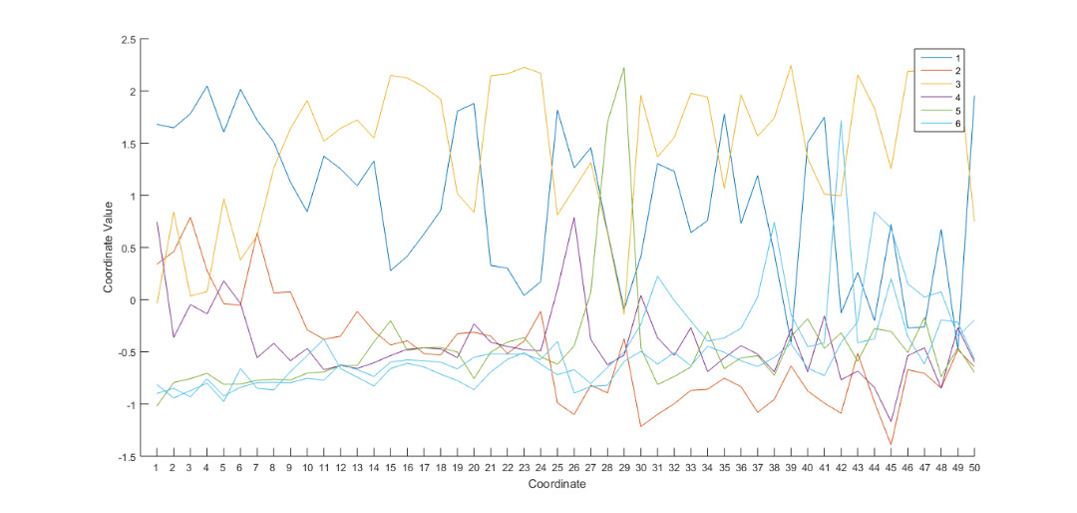
Graphical interpretation of prediction
Above shown is parallel coordinates plot of the multivariate data in the AFH matrix. Y-axis shows the AFH values, and
X-axis shows the features. The different colors plot are for different subjects. Subject 6 has 2 videos, so we can see
two closely plotted class-6 plots.

Slide 16
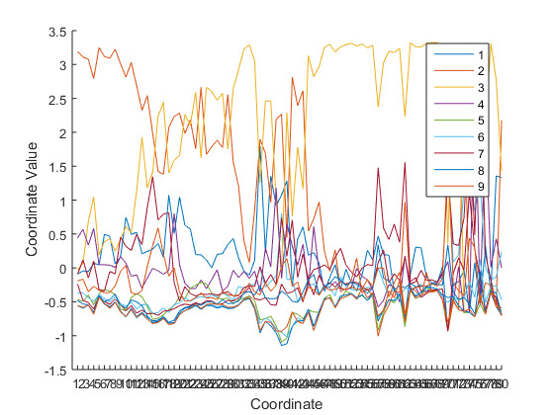
In this graph, we have 9 subjects and 25 videos, and we plot a multivariate parallel coordinates graph for them. With
sufficient data, we would get a graph similar to the one on the right, with the videos of the same person represented
as a single color band.

Slide 17
Challenges and Future aspects
We faced the following challenges, which resulted in less than expected accuracy and misclassification errors:
  The dataset and the quality of the dataset we amassed over time proved to be insufficient.
  Most of the dataset as referenced in the paper is collected in a controlled environment, which wasn’t possible for our data collection.
  The technique of optical flow used to extract features is highly sensitive to noisy data.
Future aspects :
  A more varied dataset can be collected which mirrors real-life scenarios to check the versatility of
  the classification.
  Methods other than optical flow can be tapped for extracting features, irrespective of noise in the data.
  Deep learning methods can be used for training the data.

Slide 18
References
A Gait Classification System using Optical Flow Features by Chih-Chang Yu and Kuo-Chin Fan
Github repository link : https://github.com/akankshaD/GaitAsABioMetric
Dataset link : https://drive.google.com/open?id=0B1vDbt13Vaf1SDExX3NDYm1OZVU

